Slide 1
Project 3 Cryptocurrency Trading
MAFS5440, Fall 2024

Slide 2
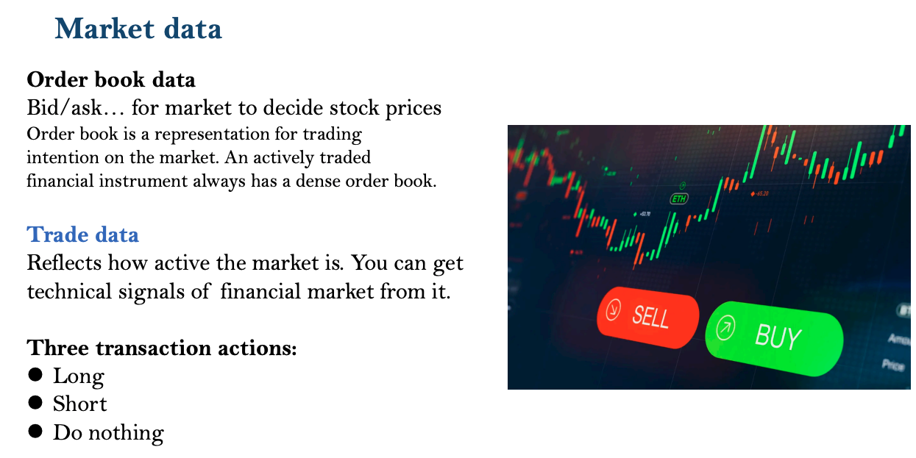

Slide 3
Data
We provide historical minute level data of four major cryptocurrencies ‘BTC(比特币)’, ‘LTC(柚子币)’, ‘ETH(以太坊)’, and ‘TRX(波场币)’ starts from ‘2021-09-14 00:00:00’ to ‘2023-04-19 00:00:00’
Get preprocessed data via:
h5 format (recommend) google drive
Non-split csv data for the 4 currencies: google drive

Slide 4
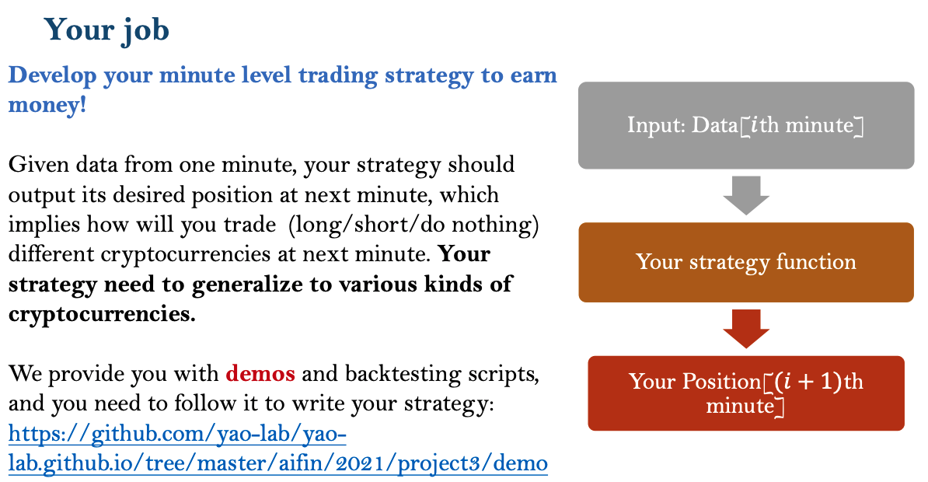

Slide 5
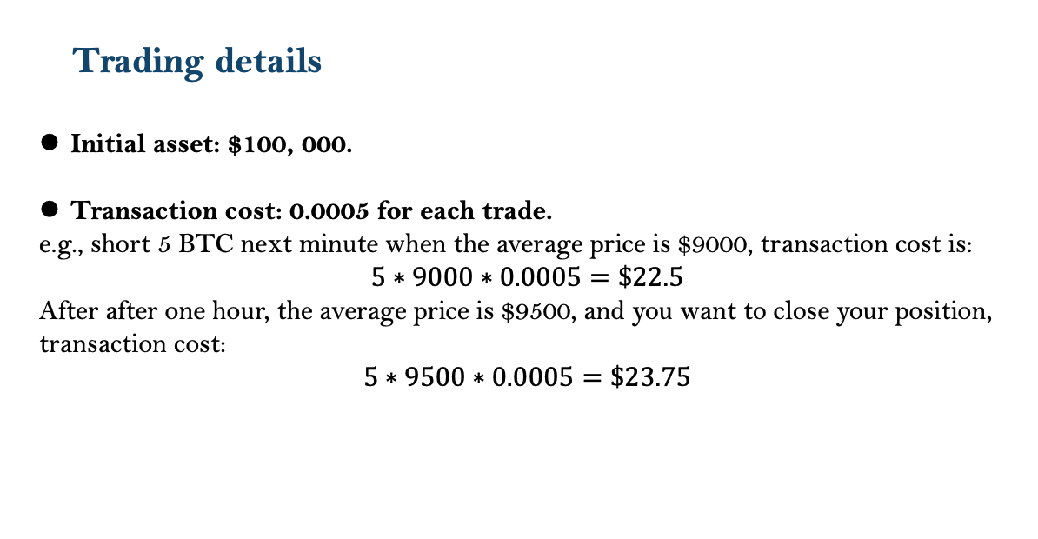

Slide 6
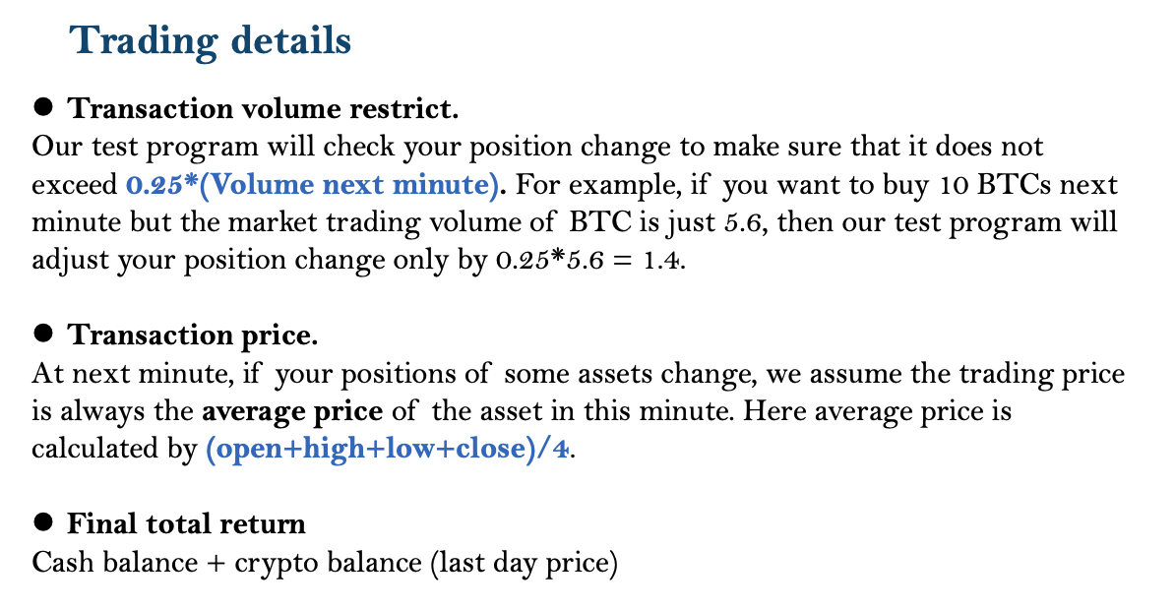

Slide 7
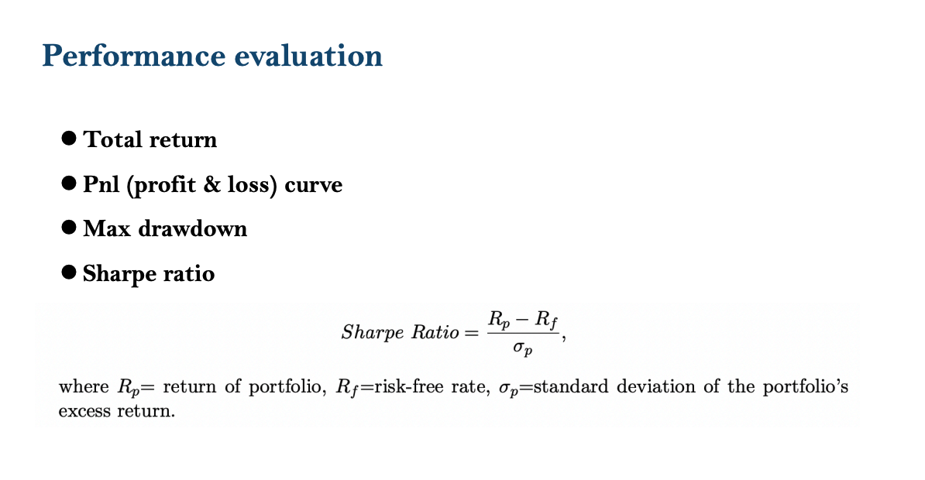

Slide 8
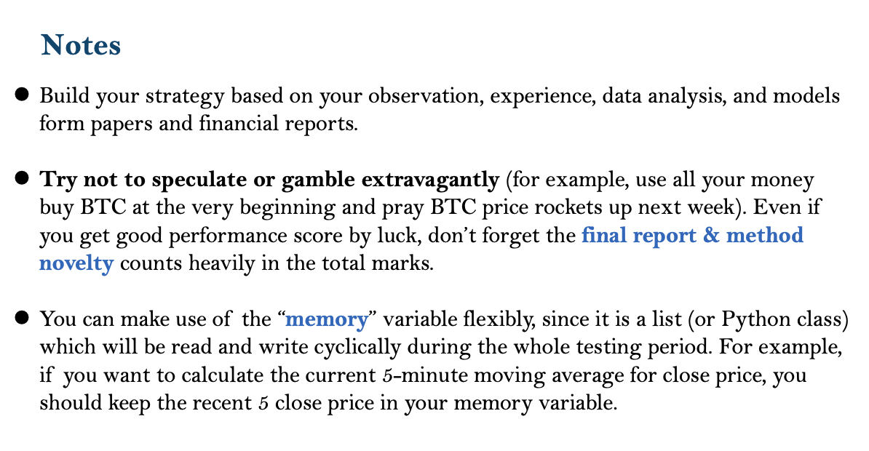

Slide 9
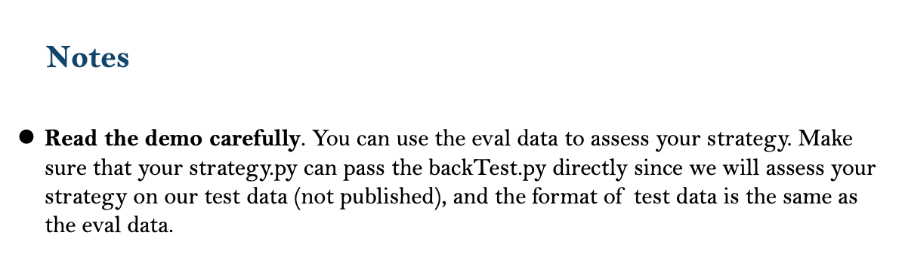

For those who wants to try more: We will provide additional historical OHLCV data with different frequencies (including ‘BTCUSD’, ‘BCHBTC’, ‘ETHUSD’, ‘LTCUSD’ transaction data in the minute /15- minute/1- hour/1-day bar). Contact with us!

Slide 10


Acknowledge to Cyril DL and Bastian Kälin for providing relevant materials and data download API.
You can get list of available books from their API https://api.bitso.com/v3/available_books/
Get historical data from Bitso (https://bitso.com) OHLC csv format.

